Slide 1
Introduction to the Generic Names Supporting Organization (GNSO) & Policy Development
23 May 2018

Slide 2
Agenda
1
2
3
Policy Development at ICANN
The GNSO and the GNSO Council
GNSO Policy Development Process
4
5
6
Engagement with other SO/ACs
A case study: new gTLD Subsequent Procedures PDP
Questions & Answers
Notes:
This is a stylized agenda slide for your presentation.
To delete a box, if there are too many boxes, click the edge of the box, ensure the entire box is highlighted, then DELETE.
To update the numbers and text, click inside the circle for the numbers or in the box for the text, revise the text.

Slide 3
How GNSO policy development differs from other SO policy development

Slide 4
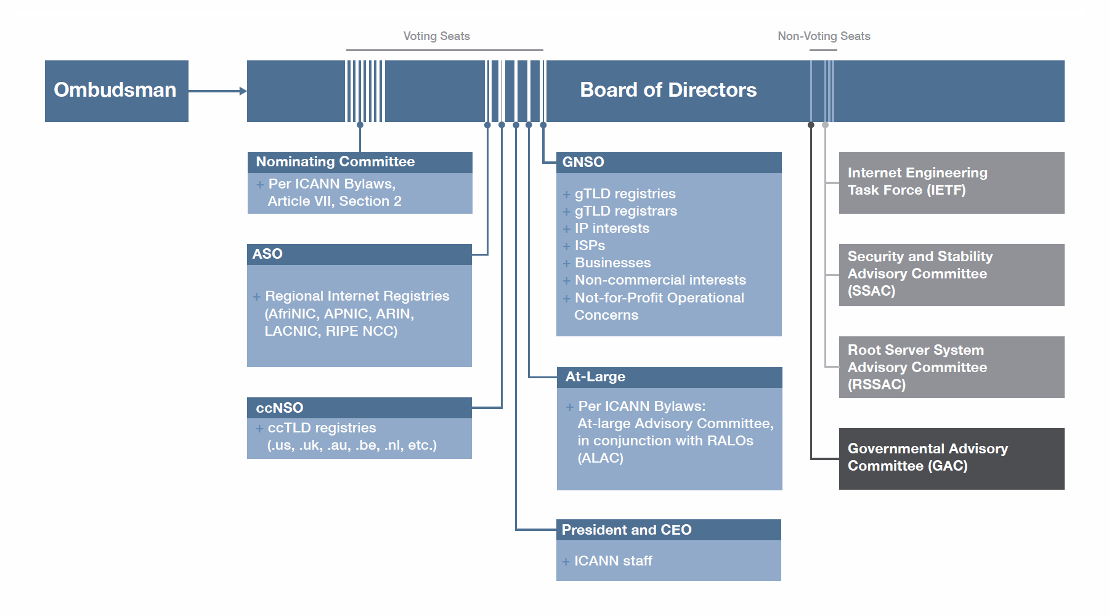
ICANN Multi-Stakeholder Model
Advisory Committees

Slide 5
ICANN Multi-Stakeholder Model
Supporting Organizations

Slide 6
ICANN Supporting Organizations
 | Generic Names Supporting Organization (GNSO) | Country Code Supporting Organization (ccNSO) | Address Supporting Organization (ASO)
Remit | Consensus policies relating to generic top-level domains (gTLDs) | Global policies relating to country-code top-level domains (ccTLDs) | Policy issues relating to the operation, assignment, and management of Internet addresses
Where does policy development happen? | At ICANN | Some at ICANN, most at national level | Regional level
Examples of current or previous policy development topics | Next Generation Registration Directory Service (RDS) New gTLD Subsequent Procedures Review of all Rights Protection Mechanisms (RPMs) | Delegation, re-delegation and retirement of ccTLDs | Allocation of remaining IPV4 Address Space (No global policies in the pipeline, for regional policies see https://aso.icann.org/global-policies/rir-regional-policies/)
Notes:
To add rows/columns <Click inside the box to add or delete columns or rows, when you right click < hit insert or delete columns to the right or left, or rows to the above or below.
The tables will auto resize, and become smaller if you add and larger if you delete.
To change the colors of the boxes, Click < Format Table < Fill < Choose your Color

Slide 7
The GNSO and the GNSO Council

Slide 8
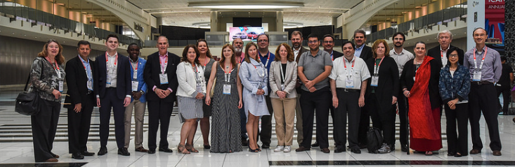
The GNSO and the GNSO Council
Generic Names Supporting Organization
GNSO is responsible for policy development related to generic Top Level Domain (e.g., .com, .net, .info, .amsterdam, .app)
21 Councilors from 6 different Constituencies / Stakeholder Groups & Nom Com appointees

Slide 9
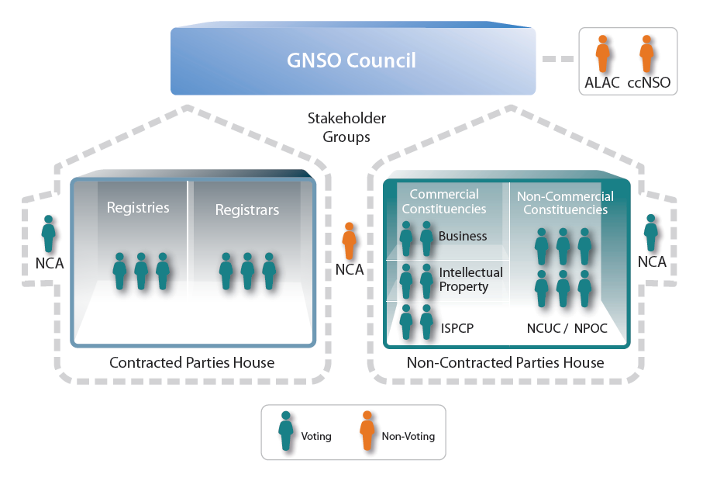
The GNSO Council Structure
Council voting happens at the house level to ensure parity between the contracted and non-contracted party house, despite a different # of Council representatives
9
Notes:
Quick overview

Slide 10
GNSO Policy Development Process (the “PDP”)

Slide 11
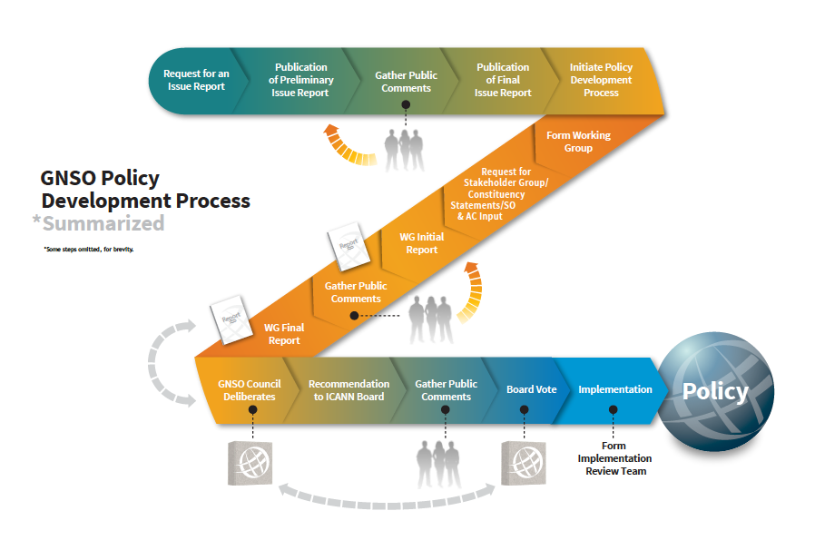
GNSO Policy Development Process

Slide 12
What is ICANN “Consensus Policy”?
All ICANN-accredited registrars and registries have contracts with ICANN that contain binding legal obligations: http://www.icann.org/en/general/agreements.htm
In this context, “Consensus Policy”* is a policy broadly supported by ICANN’s stakeholders, and which can bind ICANN-accredited registrars and registries
  Please refer to particular contracts for specific limitations and to the ICANN Bylaws for the overall context. Note that this presentation does not not constitute legal advice or a waiver or modification of any ICANN agreement

Slide 13
“Consensus Policy”
In their contracts with ICANN, registries and registrars agree to comply with “consensus” policies adopted by ICANN; provided that (i) such policies do not unreasonably restrain competition; and
(ii) the policies relate to:
  Issues for which uniform or coordinated resolution is reasonably necessary to facilitate interoperability, technical reliability and/or stable operation of the Internet or Domain Name System;
  Registry / registrar policies reasonably necessary to implement Consensus Policies relating to registrars/registries; and
  Resolution of disputes regarding the registration of domain names (as opposed to the use of such domain names)
Detailed topics subjected to “Consensus Policy” are also further defined in the gTLD Registry and Registrar Agreements

Slide 14

“The Picket Fence”
The general policy making authority granted to ICANN to preserve the stability and security of the DNS and the policy authority described in previous slide create a “picket fence” around ICANN’s authority
ICANN could establish policy and/or best practices affecting issues outside the picket fence, but could not mandate registry and registrar compliance with such policies. Issues considered outside of the picket fence include, for example, pricing.

Slide 15
What are the Tools and Mechanisms used?
The PDP Working Group model
Meetings: in-person, teleconference
Public comments are critical
Online collaboration mechanisms
Regular publications & briefings
Webinars & updates
These tools all support
bottom-up, consensus policies and guidelines

Slide 16
Important facts about participation
Anyone can participate in a GNSO PDP Working Group, if that is the chosen model for the PDP Team
Anyone can join a Working Group as a Member or Observer
Participation in a GNSO Working Group currently remains open throughout the lifecycle of the project
Much policy development work occurs regularly throughout the year, not just at ICANN meetings
Although attending an ICANN meeting is useful, all Working Groups conduct their work via conference calls, mailing lists and virtual meeting rooms

Slide 17
PDP 3.0
GNSO Council is currently considering incremental improvements to the PDP to enhance efficiency and effectiveness of GNSO policy development activities. Improvements are focusing on the following areas:
Working Group dynamics
Working Group leadership
Complexity of subject matter
Consensus building
Role of the Council as the manager of the PDP

Slide 18
Where to find more information
Sign up for the various ICANN regional newsletters to get news about selected policy work, current public comment opportunities and upcoming webinars
Sign up for the Policy Update webinars, scheduled before each ICANN meeting
Check out the GNSO web-site for further information: http://gnso.icann.org

Slide 19
Engagement with other SO/ACs

Slide 20
Engagement with other SO/ACs
The GNSO Council has a liaison FROM the ALAC and the ccNSO as well as a liaison TO the GAC and the ccNSO, as well as joint meetings with the ccNSO and GAC at ICANN meetings.
Numerous opportunities for SO/ACs to provide input to the PDP process, e.g. specific input requested at an early stage of the process as well as various opportunities for public comment
Specific mechanisms created to facilitate early engagement by the GAC in policy development mechanisms as a result of the GAC-GNSO Consultation Group, including the Quick Look Mechanism to identify whether or not a PDP is expected to raise public policy concerns.
None of these engagement opportunities negate other SO/ACs’ performance of their role as described under the Bylaws.

Slide 21
A Case Study: new gTLD Subsequent Procedures PDP

Slide 22
What is the PDP about?
GNSO recommendations from 2007 resulted in the Applicant Guidebook and the 2012 round of the New gTLD Program.
The New gTLD Subsequent Procedures PDP (“SubPro”) is focused on considering the 2012 round policy and determining what changes might need to be made to the original GNSO recommendations from 2007.
The PDP was chartered and began its work in early 2016
  Charter available here: https://gnso.icann.org/en/issues/new-gtlds/subsequent-procedures-charter-21jan16-en.pdf

Slide 23
How is the PDP Structured?
The PDP has two overall co-chairs: Jeff Neuman and Cheryl Langdon-Orr
The PDP has over 40 separate topics identified in its charter and broke into sub team work tracks to tackle work:
  Work Track 1: Overall Process/Support/Outreach (Christa Taylor and Sara Bockey)
  Work Track 2: Legal/Regulatory (Michael Flemming and Sophia Feng)
  Work Track 3: String Contention, Objections, Disputes (Karen Day and Robin Gross)
  Work Track 4: IDNs, Technical & Operations (Rubens Kuhl and Cheryl Langdon-Orr)
Work Track 5: Geographic Names at the Top-Level (Annebeth Lange, Javier Rúa-Jovet, Martin Sutton, and Olga Cavalli)
All Work Tracks will submit their work to the whole WG for review and approval

Slide 24

What is the Role of the PDP Leadership?
Serving as a leader in this PDP, and any other GNSO PDP, is more about ensuring process is followed, including scheduling meetings, presiding over those meetings, ensuring PDP members are able to provide their contributions, and to deliver the WG’s results to the GNSO Council.
The overall WG co-chairs come from the GNSO and ALAC, while Work Track 5 has co-leads from each of the ALAC, ccNSO, GAC, and GNSO. However, as noted, the role of leadership is about ensuring debates take place in an open and transparent fashion and that different viewpoints are able to be shared, and not serving as advocates for their particular position or that of their organization.

Slide 25

Who Can Participate?
Anybody is welcome to participate, as long as they complete a Statement of Interest.
The overall PDP has ~180 members and ~80 observers, with participation from ALAC, ccNSO, GAC, individuals, and all GNSO Stakeholder Groups/Constituencies
Work Tracks 1-4 have ~40-60 members, also with broad representation
Work Track 5 has ~155 members and ~90 observers, including 24 members from the GAC

Slide 26

How Does the PDP Operate?
Most of the PDP’s work takes place during conference calls with members (every week or every other week)
However, the PDP convenes for face-to-face sessions at ICANN meetings, discussing issues with the wider community
The PDP tracks its work in a number of ways, with everything available on the dedicated Wiki space (https://community.icann.org/x/RgV1Aw):
  Recordings, transcripts (for full WG), and notes from all meetings
  Working documents used to capture deliberations
  Data requests, background materials, and other inputs
Among other things, the Wiki also includes attendance records for all meetings, the PDP’s work plan, action items, etc.

Slide 27
How Does the PDP Engage With the Community?
  Early Engagement with the GAC
  Request for past/existing Advice and Statements from SO/AC/SG/Cs
  Monthly Newsletters
  Community Comment 1 (on overarching issues)
  Community Comment 2 (the rest of the charter topics, via direct outreach and published for public comment)
  At ICANN Meetings:
  Face-to-face working sessions
  Cross-community sessions
  Direct engagement with community groups (e.g., ALAC, GAC) on topics of particular interest

Slide 28
PDP 3.0 – Example of Some Practices in Place
  Re-establishing the relationship with GNSO Council liaisons to the PDP - for the SubPro PDP, there are two (Donna Austin and Keith Drazek).
    Participation in leadership coordination and planning meetings
  Working towards deadlines and making sure Council liaisons are informed
  After the Initial Report is published and the WG works towards its Final Report, additional practices may be needed:
  May need to divide the content into “chunks” to be able to make progress on the large amount of content
  Getting to consensus will require effective listening and leadership
  Strong adherence to a work plan

Slide 29
What is Coming Next for the PDP?
  Will publish Initial Report on Work Tracks 1-4 for public comment
  Then, consider public comment on Initial Report and work towards completion and delivery of Final Report to GNSO Council for its consideration.
  Engage with the community at ICANN62, including cross community sessions on geographic names at the top-level
  Will publish a separate Initial Report on just geographic names at the top-level

Slide 30
What Happens After the PDP delivers its Final Report?
  This PDP is seeking to deliver its Final Report to the GNSO Council in early 2019.
  From that point, these are some of the expected next steps (as with the conclusion of any PDP):
    GNSO Council consideration and adoption of the PDP recommendations in the Final Report
    Council report to Board / Public Comment
    ICANN Board consideration and adoption of the PDP recommendations as adopted by GNSO Council
    ICANN org (as directed by the Board) to begin implementation of the PDP recommendations (which will likely include a revised Applicant Guidebook)

Slide 31
PDP Resources
  Active Project Page: https://gnso.icann.org/en/group-activities/active/new-gtld-subsequent-procedures
  PDP Wiki: https://community.icann.org/x/RgV1Aw
  PDP Mailing List Archive: http://mm.icann.org/pipermail/gnso-newgtld-wg/
  Newsletters: https://gnso.icann.org/en/news/working-group-newsletters
  Pre ICANN Meeting GNSO Policy Briefings: http://go.icann.org/policybriefing
    Archive: https://gnso.icann.org/en/issues/background-briefings/archive

Slide 32
Questions & Answers

